Slide 1


Slide 2


Slide 3


Slide 4
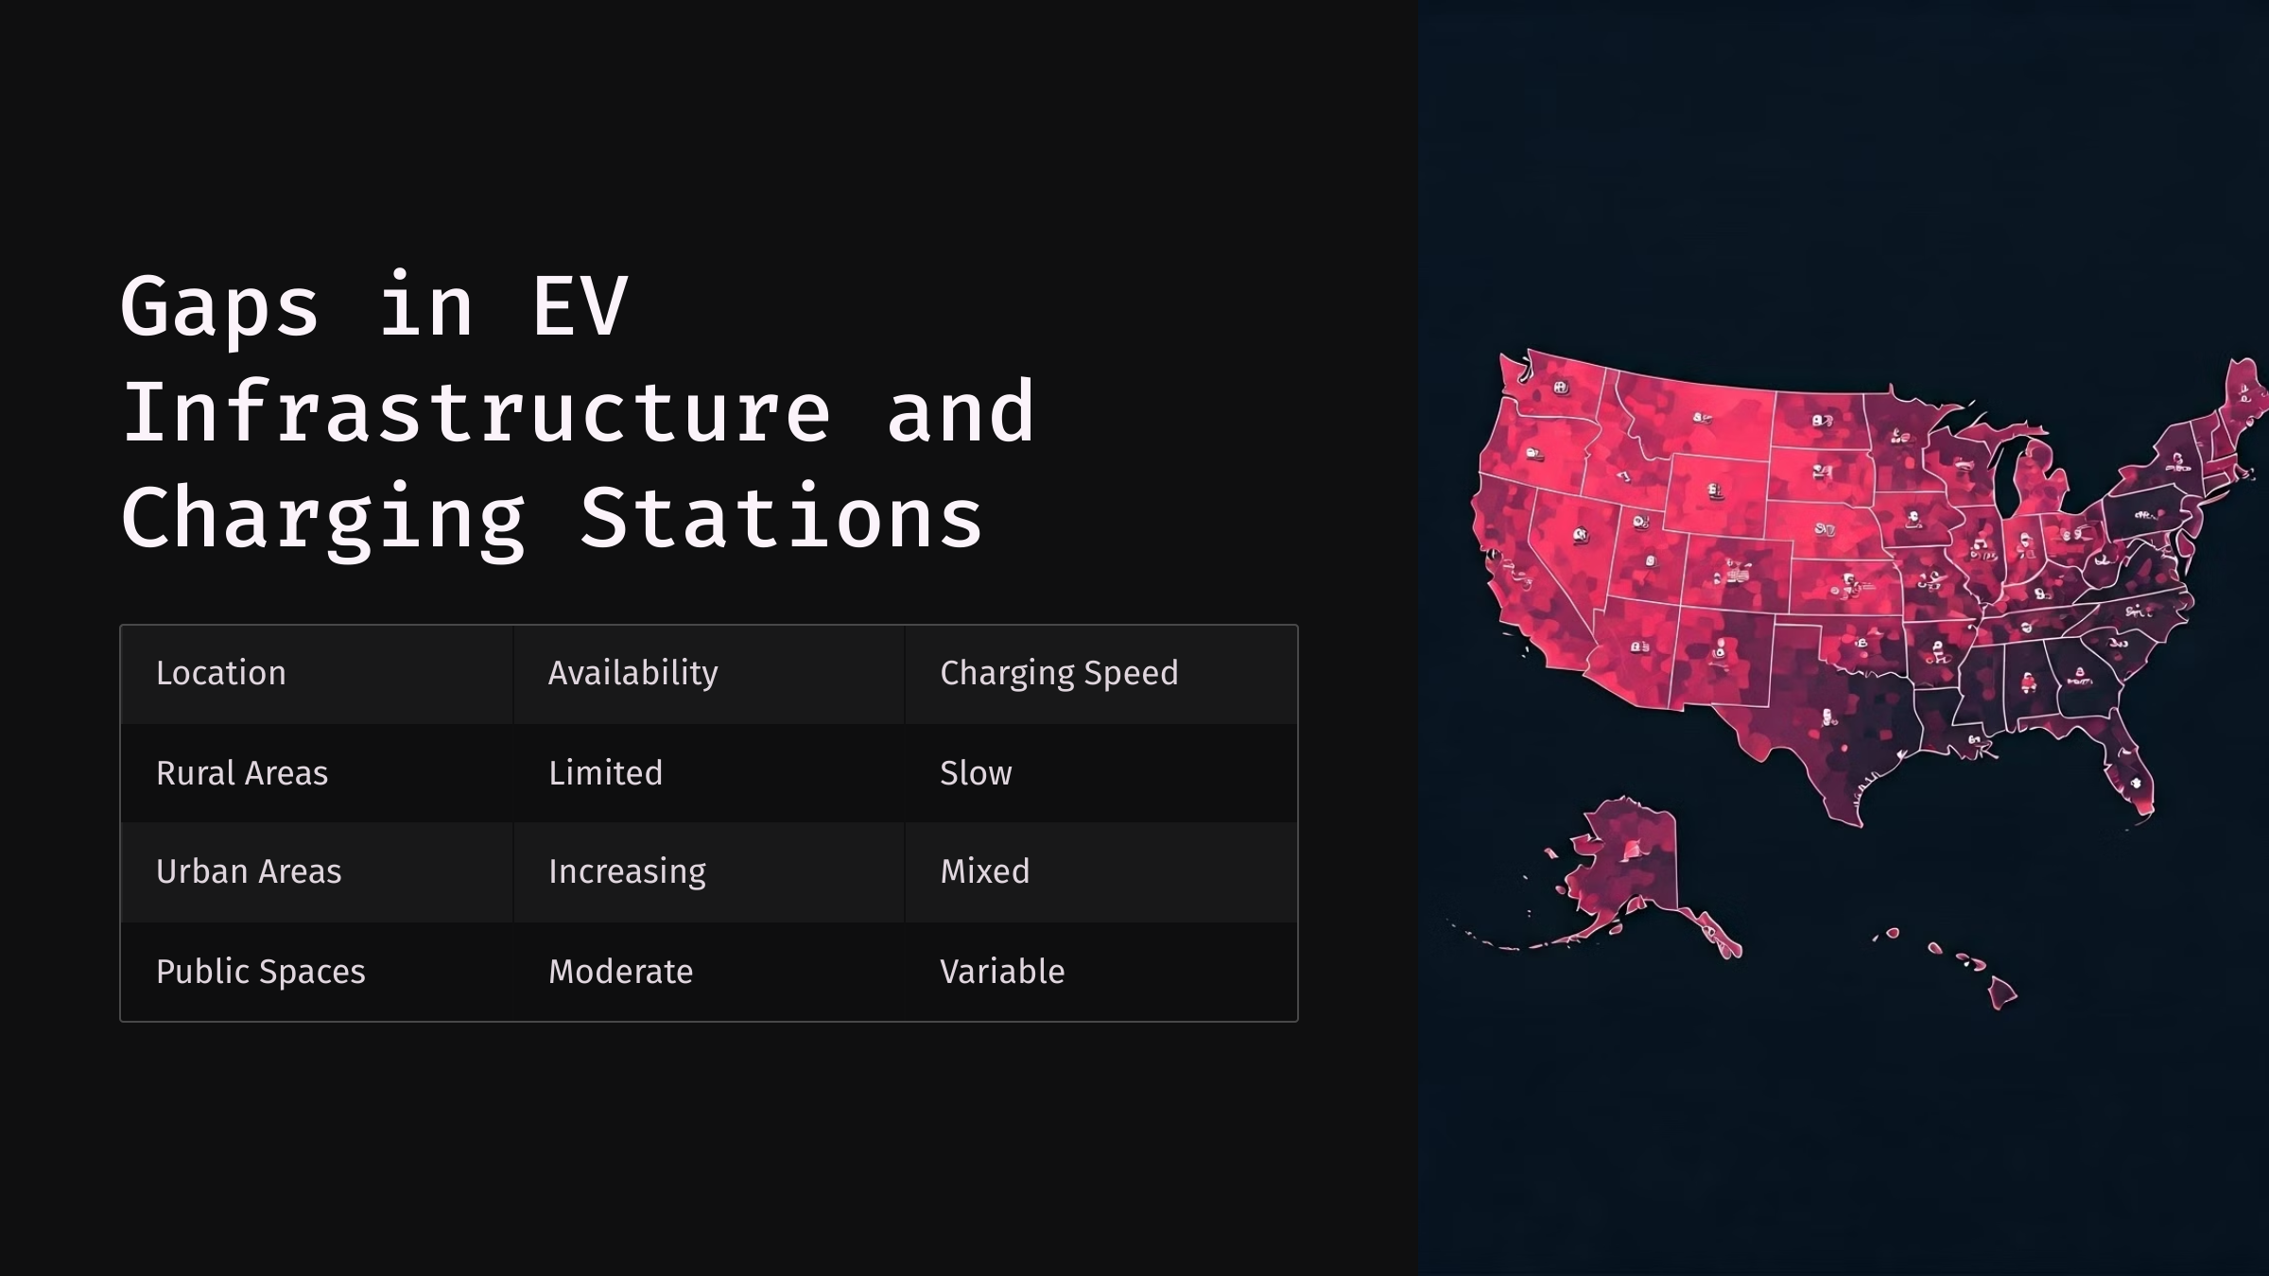

Slide 5


Slide 6


Slide 7
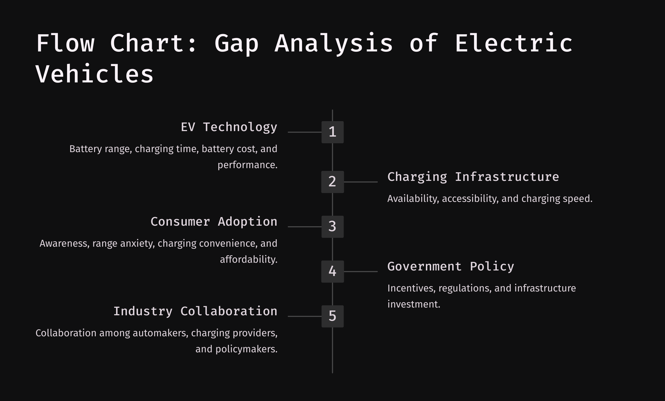

Slide 8
CT&DT – SPSU – “TEAM SCOUT” – TASK#07
TEAM MEMBERS:
NAVEEN.C
CHARAN TEJA.K
HARI NAVEEN.M
KUSHAL MENARIYA
MAHESH LOHAR
JAGADEESH.A

